Slide 1
Getting Started with Azure Blueprints

Slide 3
Interlude
A short rant about naming things

Slide 4
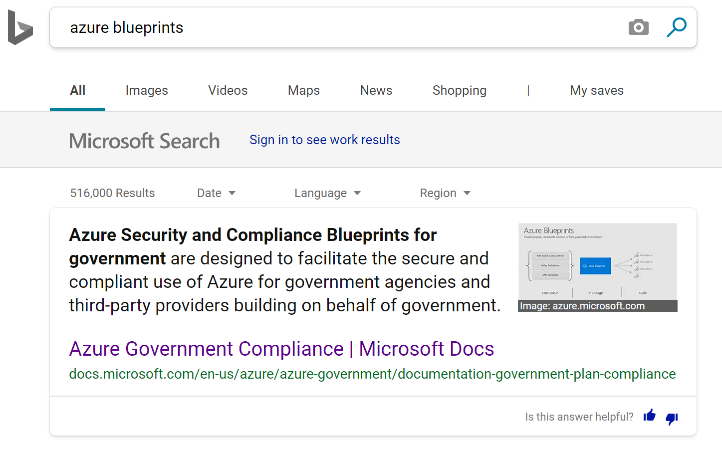

Slide 5
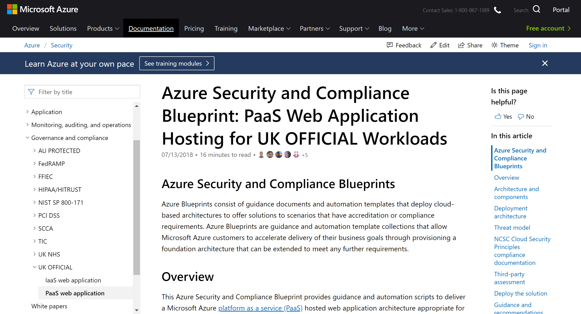
Notes:
These blueprints are in https://docs.microsoft.com/en-us/azure/security/

Slide 6
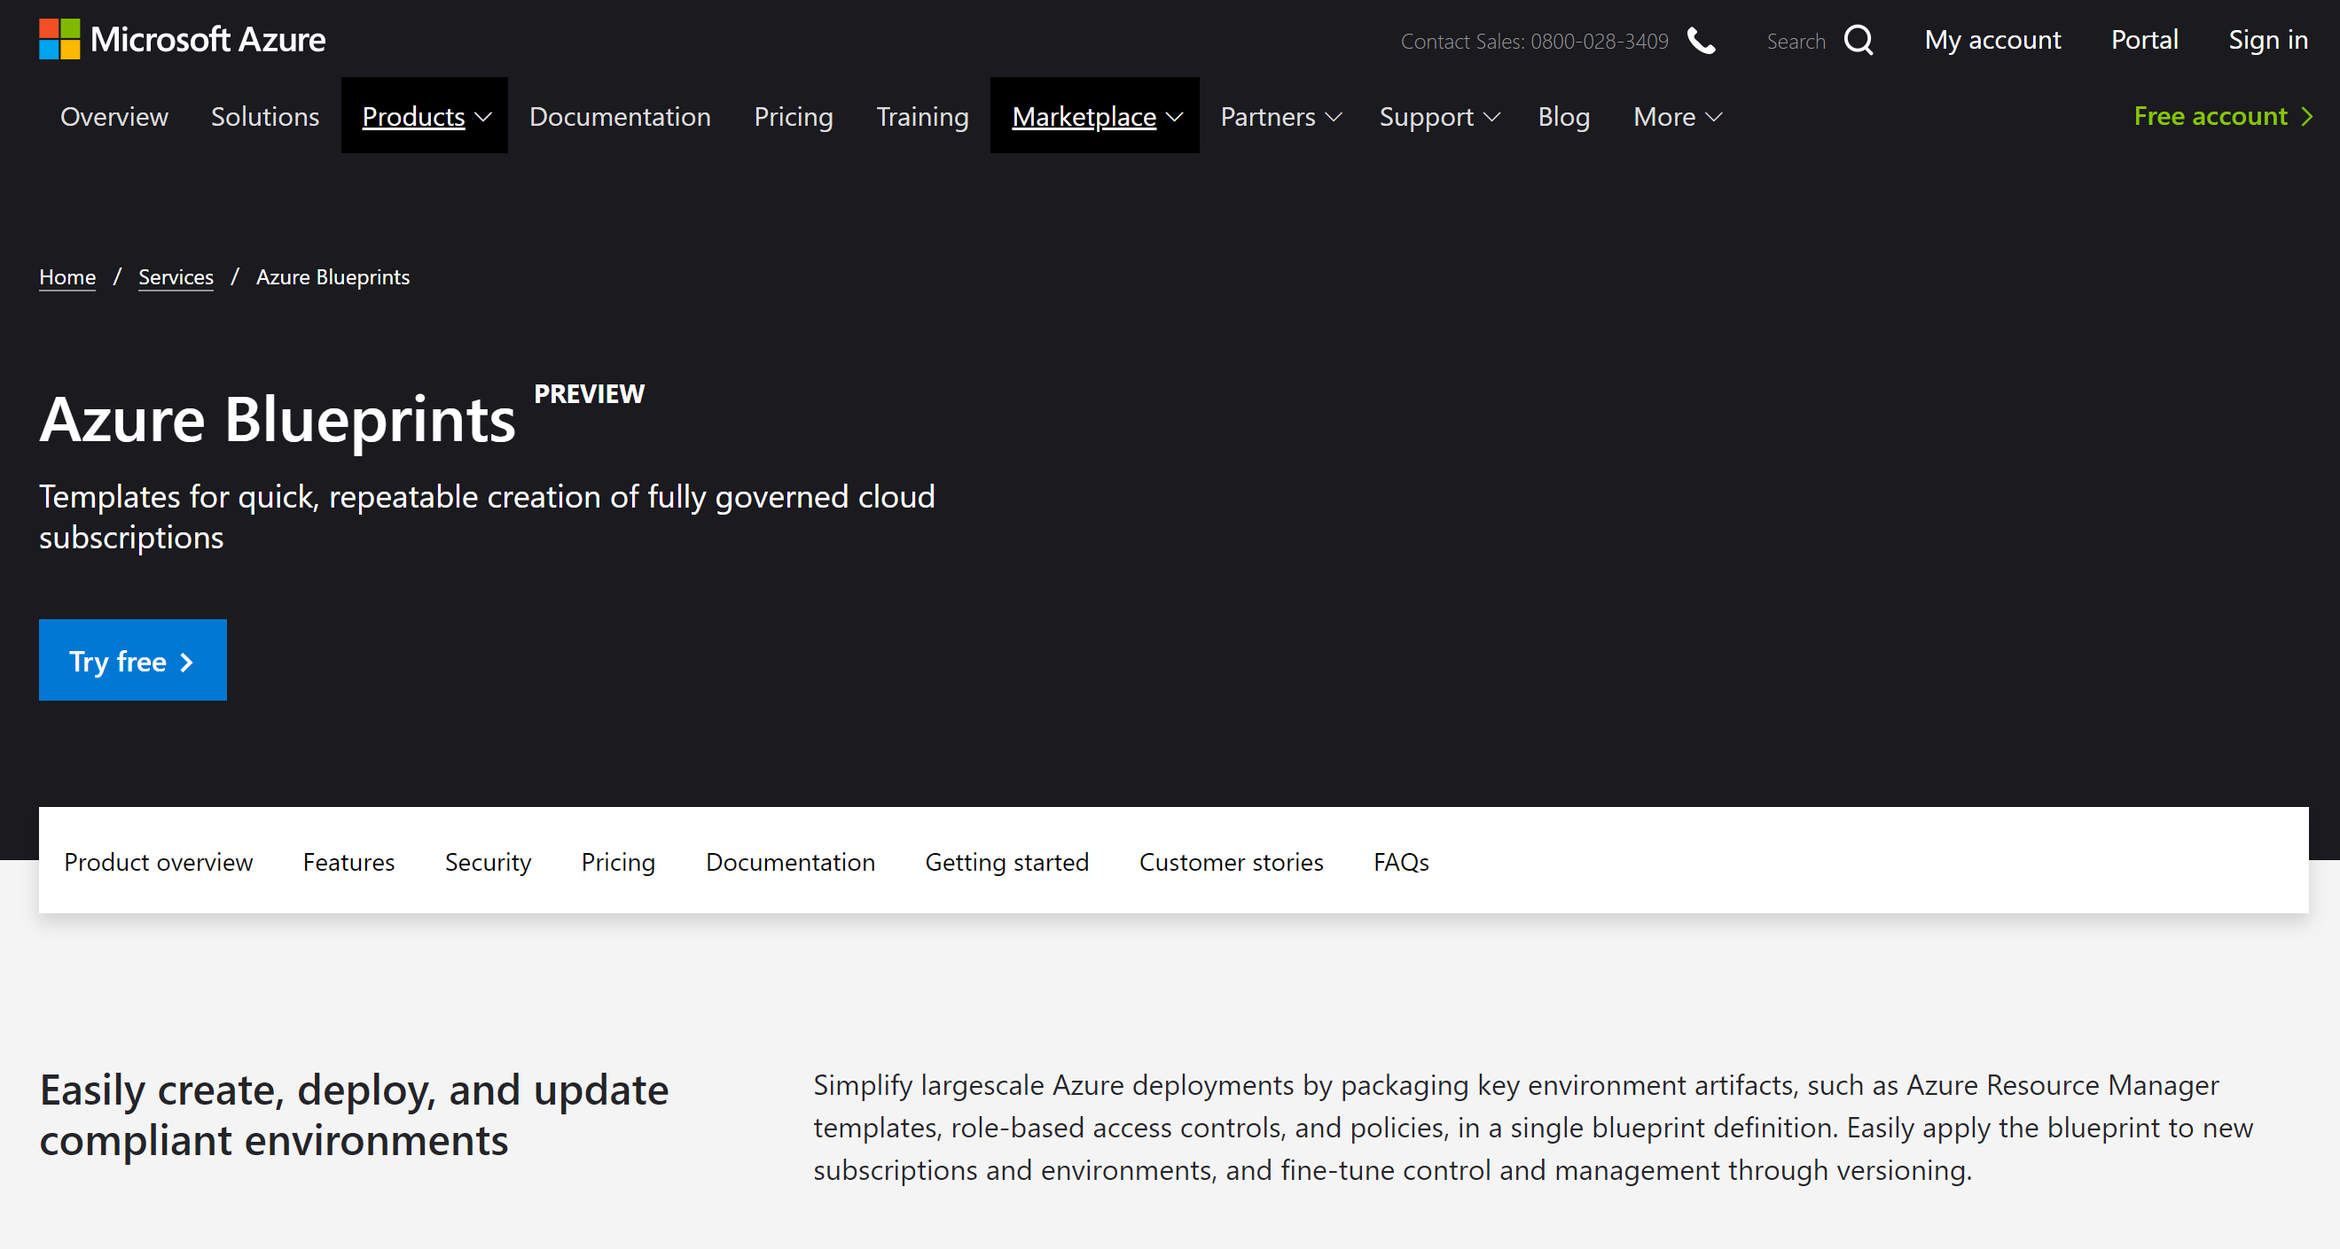
Notes:
These blueprints are in https://azure.microsoft.com/en-us/services/blueprints/ and https://docs.microsoft.com/en-us/azure/governance/blueprints/

Slide 7
What are Azure Blueprints?
Azure BluePrints are not Azure BluePrints
But, some of parts of some of the Azure BluePrints have been created to deploy through Azure BluePrints
I’m glad we cleared that up!

Slide 8
Governance in Azure

Slide 9
The Problem
Good practice pushes us to have several subscriptions for different purposes/products/customers, etc
Compliance requirements make us document our processes and need us to audit what we do
Manually setting permissions, etc is prone to failure

Slide 10





Governance for the cloud
NEW
NEW
NEW
Management Group
Policy
Blueprints
Resource Graph
Cost Management
Define organizational hierarchy
Real-time enforcement, compliance assessment and remediation
Deploy and update cloud environments in a repeatable manner using composable artifacts
Query, explore & analyze cloud resources at scale
Monitor cloud spend and optimize resources
Hierarchy
Control
Environment
Visibility
Consumption
Notes:
Azure governance consists of 5 capabilities (Policy, Blueprints, Resource Graph, Management Group, Cost Management) to ensure you will have the right tools for your applications or workload teams, so they can use cloud resources in an accountable & responsible fashion.

Slide 11

Azure Governance Architecture
Providing control over the cloud environment, without sacrificing developer agility
Policy Definitions
Role-based Access
ARM Templates
Azure Portal
CLI
3rd party
Environment factory Deploy and update cloud environments in a repeatable manner using composable artifacts
Policy-based control Real-time enforcement, compliance assessment and remediation at scale
Resource visibility Query, explore & analyze cloud resources at scale
Subscriptions
Management Groups
CRUD
Query
Azure Blueprints
Azure Resource Graph
Policy Engine
Azure Resource Manager (ARM)
Virtual Machine
Storage
Network
Resource Provider
Notes:
Lets take a look at how these services fit with each other:
Azure Policy sits on ARM, which means that you can apply policies to every service exposed to ARM.
Blueprints are built from ARM templates, so it is also engrained in the platform
Azure Resource Graph caches all the information from ARM rather than making calls every time you need information, making more efficient the exploration process
Management groups are a feature of the portal, which works along policies and blueprints to make subscription management and governance much easier to implement.

Slide 12
Azure Management Groups
Efficiently apply governance controls and manage groups of Azure subscriptions
1
`2
3
Fit your organization
Apply controls at scale
Simplify subscription management
Create a flexible hierarchy that can be updated quickly
Mirror the hierarchy to the organizational model that works for you
Scale up or down depending on the organizational needs
Leverage Azure Resource Manager (ARM) objects that integrate with other Azure services
Azure services:
Azure Policy
RBAC
Azure Cost Management
Azure Blueprints
Azure Security Center
Group subscriptions into logical groups
Inherit properties that apply to all subscriptions
View aggregated information above the subscription level
Notes:
Lets go deeper into management groups. We have customers that have multiple subscriptions, some in the hundreds of subscriptions. This makes it more difficult to manage them because you have to manage one by one. Management groups essentially are buckets of subscriptions, and you can even create buckets of buckets to create hierarchies that map your organization or any other structure you want to implement. They are integrated with several Azure services like Azure Policy or Cost Management, so you can do things like applying a policy to the management group level and it will cascade down to each subscription, or get an understanding of the cost at that management group level.

Slide 13

Management Group & subscription modeling strategy
Org Management Group
Prod RBAC + Policy
Pre-Prod RBAC + Policy
App A
Prod
App B
Prod
App A
Pre-Prod
App B
Pre-Prod
Microsoft recommended
App D
Prod
Shared services
(Prod)
App C
Pre-Prod
Shared services
(Pre-Prod)
Notes:
In the past we have talked about subscription modeling strategy in terms of resource groups. Our recommendation is to choose resource groups or management groups depending on the size of your applications. Smaller applications should use resource groups, but if you have a larger application the recommended practice is to use something like what is shown here, which has a subscription for every app that is part of a type of environment, in this case prod and pre-prod. The reason is that all those will need to get the same policies. As an example, pre-prod should not have access to the public internet since it would be a vulnerability. You can apply such policy at the management group level and make sure that type of environment is secure.

Slide 14
Azure Policy
Active control and governance at scale for your Azure resources
Enforcement & compliance
Apply policies at scale
Remediate & automate
Turn on built-in policies or build custom ones for all resource types
Real-time policy evaluation and enforcement
Periodic & on-demand compliance evaluation
VM In-Guest Policy
Apply policies to a Management Group with control across your entire organization
Apply multiple policies and & aggregate policy states with policy initiatives
Exclusion Scope
Remediate existing resources at scale
Automatic remediation resources at deployment time
Trigger alerts when a resource is out of compliance
Notes:
Azure policy sits at the core of Azure, and gives you the ability to codify your company policies into the platform. Once core benefit is that, given the rate of innovation of Azure, there are services going live quite often. In Azure, any news service will be able to be governed by Azure Policy from day 1.
There are essentially three kinds of policies:
Auditing is the one we recommend getting started with. This means that users can use Azure with no restrictions, but if somebody goes against policy you will be able to see the compliance state in an easy to use view. No need to run scripts every 24 hours to check the compliance status.
Enforce policies is the next level where essentially you are setting guardrails. This means that if you have an enforced policy, users have to do it that way or they will get a deny error.
Remediation is the last type, where you can get back to desired state the resources that are non-compliant. Imagine that you need to have monitoring in your VMs and there are multiple non-complaint ones. You can trigger a remediation policy that will append monitoring to those resources.

Slide 15



Enforce policies as part of the development process
Shift left to deliver compliant code faster
Pre-flight
Code
Build/Test
Deploy
Operate
Validation
Policy as Code
Authoring
Policy
Security
Monitoring
Azure DevOps
Notes:
So we have talked about the shift in roles from Ops to cloud custodian, and how the cloud custodian is an enabler instead of a blocker. Lets look at how the cloud custodian can make that happen in the CI/CD pipeline through Azure Policy.
Code, Build/Test, Deploy, Operate– a tube and move the policy from the operate side to the build side. The migration tube polled out with red.
Right now all compliance processes during the devops lifecycle happen at the end of the cycle. These are all the manual checks and approval processes that need to be completed before code is committed and merged.
We are allowing cloud custodians to shift the compliance process left. Now policies are enabled from the beginning, which means that as code is been developed, Azure Policy flags any compliance issues proactively so developers can make the required changes right away and commit their code knowing that it is fully complaint.

Slide 16

Enforce policies as part of the development process
Shift left to deliver compliant code faster
Pre-flight
Code
Build/Test
Validation
Deploy
Operate
Policy as Code
Authoring
Policy
Security
Monitoring
Azure DevOps
Azure Policy
Notes:
So we have talked about the shift in roles from Ops to cloud custodian, and how the cloud custodian is an enabler instead of a blocker. Lets look at how the cloud custodian can make that happen in the CI/CD pipeline through Azure Policy.
Code, Build/Test, Deploy, Operate– a tube and move the policy from the operate side to the build side. The migration tube polled out with red.
Right now all compliance processes during the devops lifecycle happen at the end of the cycle. These are all the manual checks and approval processes that need to be completed before code is committed and merged.
We are allowing cloud custodians to shift the compliance process left. Now policies are enabled from the beginning, which means that as code is been developed, Azure Policy flags any compliance issues proactively so developers can make the required changes right away and commit their code knowing that it is fully complaint.

Slide 17
Azure Blueprints
Enabling quick, repeatable creation of fully governed environments
Streamline environment creation
Enable compliant development
Lock foundational resources
Centralize environment creation through templates
Add resources, policies and role access controls
Track blueprint updates through versioning
Empower developers to create fully governed environments through self-service
Create multiple dev-ready environments and subscriptions from a centralize location
Leverage the integration with Azure Policy on the DevOps lifecycle
Ensure foundational resources cannot be changed by subscription owners
Manage locks through a centralize location
Update locked resource through blueprint definition updates
Notes:
Azure Blueprints is a new service that we announced at Ignite 2018. To get an understanding of what it is, imagine that you can have an ARM template with all your resources, and add to that policies and role based access controls. That is what blueprints is. It allows you to deploy fully governed environments, and you can share or deploy blueprints with multiple subscriptions or management groups as needed, essentially giving you the ability to stamp out environments.
They can be managed from a central location and they have the ability to track versioning and even lock resources that you don’t want subscription owners to change.

Slide 18

Azure Blueprints
deploy and update cloud environments in a repeatable manner using composable artifacts
Role-based access controls
Policy Definitions
Subscription A
ARM Templates
Azure Blueprints
Subscription B
Subscription C
…
Compose
Manage
Scale
Notes:
This is essentially how blueprints works. You have your artifacts on the left hand side that compose a blueprint. You manage it from a central location, including where to deploy, versioning and locking. Then you scale but applying to subscriptions or in the short term, management groups.
We are also introducing built0in blueprints, which allow customers to have a pool of built-in blueprints to choose from fro the most common scenarios, like ISO 27001 or internal security.

Slide 19
Azure Resource Graph
Get visibility into your resources for effective inventory management
Explore your resources
Query & analyze
Assess impact
Get visibility into your Azure resources across subscriptions and management groups.
Access the information you need in the portal, CLI or PowerShell
Find assets based on resource properties or their relationships
Get the exact information you need through queries in seconds
Perform analysis at scale across all your environments
Leverage Keyword Query Language for easy query creation
Understand the impact of applying policies before their implementation
Get a view of the operational impact of common actions like deprecations
Notes:
Azure resource graph help you with inventory management and discoverability of the resources you have in Azure. Seems like a simple task, but before resource graph customers where making scripts that would get this information by doing calls to ARM. This poses the problem that ARM has a limit on the calls that you can make to it, and it locks you down once reached.
ARG takes a different approach, and caches all the information so you can get it in seconds.
You can use it on the portal or take advantage of powerful querying through poweshell by using KQL.

Slide 20
Azure Cost Management
Monitor cloud spend
Drive organizational accountability
Optimize cloud efficiency
Track usage and cost trends
Detect spending anomalies and usage inefficiencies
Forecast future spend using your historical data
Visualize data in consolidated or custom dashboards
Allocate usage and costs to business units and projects
Produce chargeback and show back reports
Let teams access data and insights with Role-Based Access Control
Automatically alert stakeholders of spending anomalies and overspending risks
Increase resource utilization with virtual machine right-sizing
Eliminate idle resources
Improve virtual machine reserved instances management
Pay less for Windows Server and SQL Server resources through Azure Hybrid Benefit
Notes:
And lastly Cost management. On Sept 2017 we announced the acquisition of Cloudyn as Azure’s cost management service. Over this time we have learnt a lot from it and we have built a brand new cost management service from the ground up, which we call Azure Cost Management. It has improved performance compared to Cloudyn with <8hrs latency, better user experience and great integration with Azure services like tagging, management groups and action groups.
ACM allows you to monitor what you spend by doing cost analysis on easy to sue dashboards. You can create accountability across your teams by setting budgets, and you can optimize by taking advantage of Azure Advisor recommendations, Reserved Instacnes and Azure Hybrid Benefits

Slide 21
Demo

Slide 22
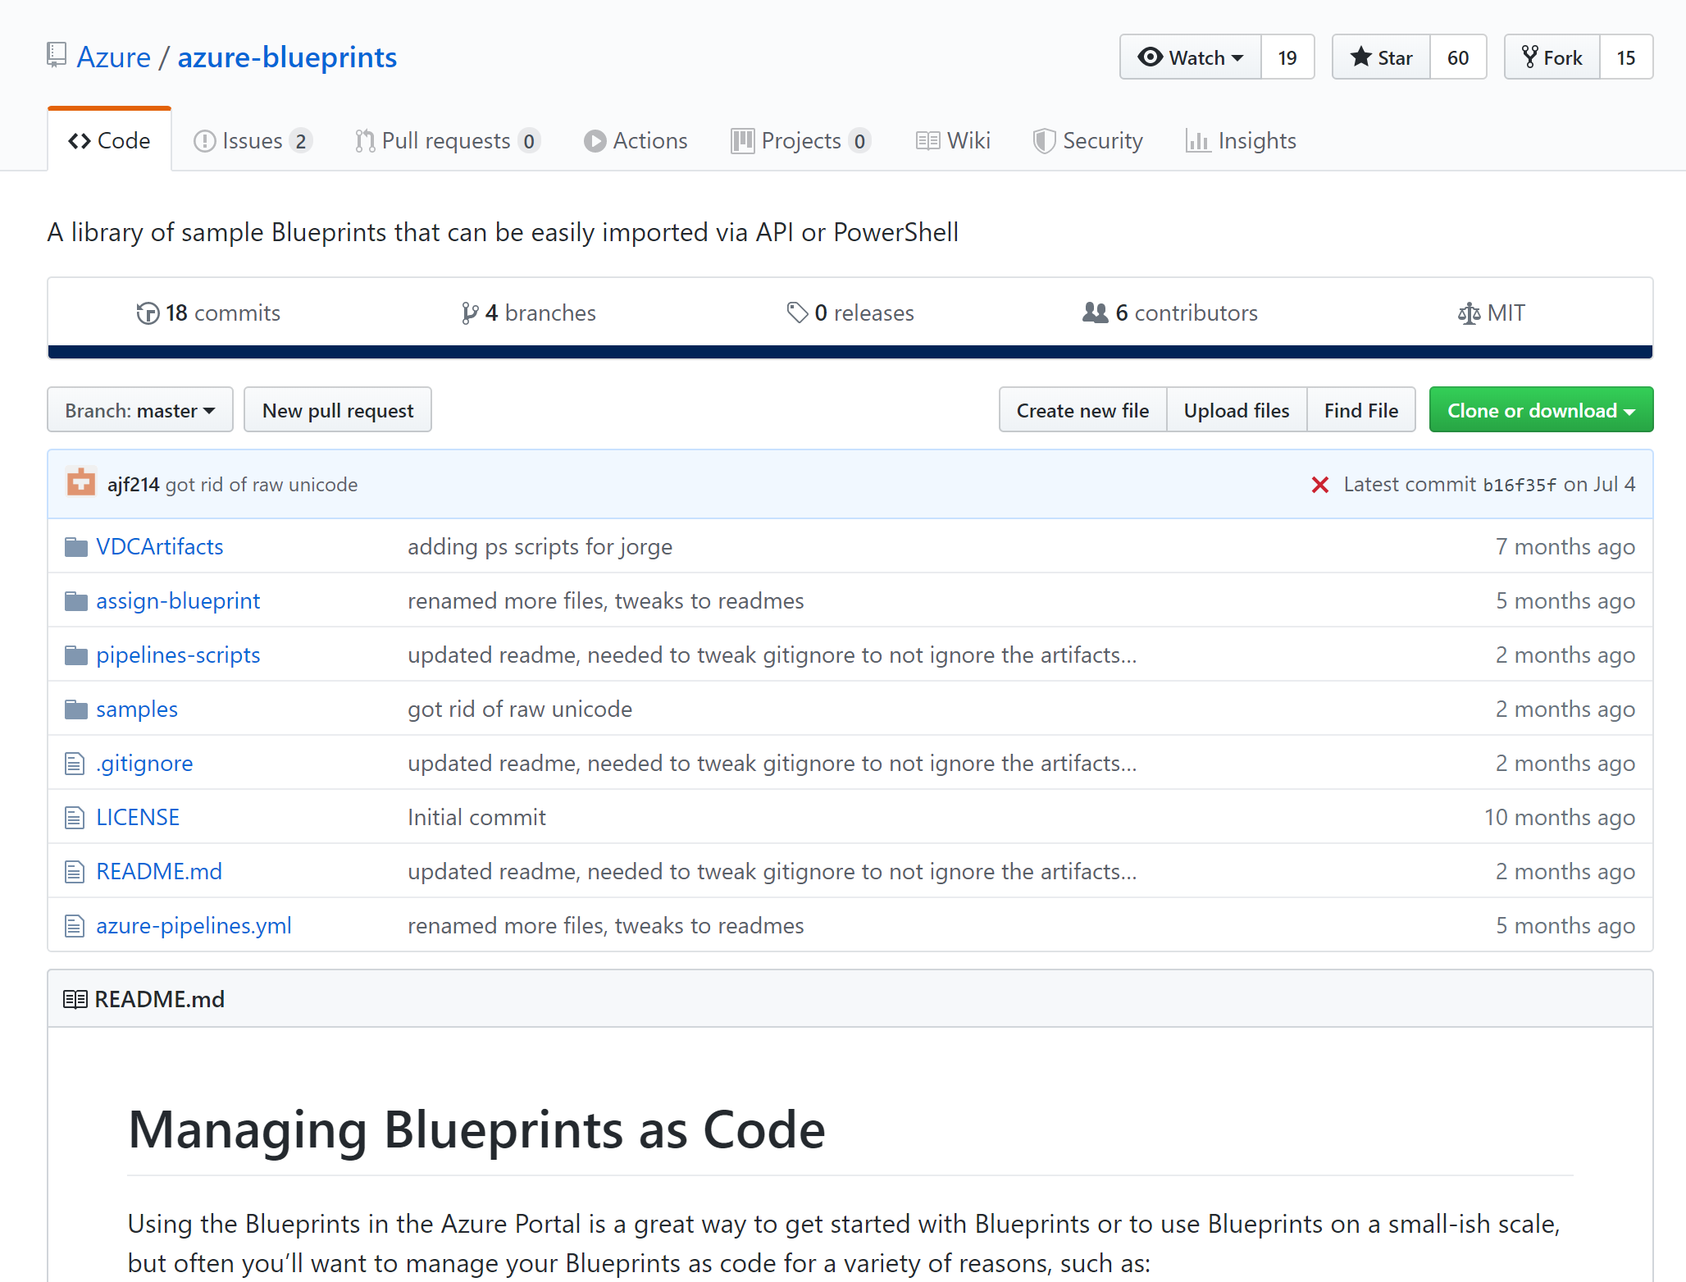
Notes:
https://github.com/Azure/azure-blueprints

Slide 23
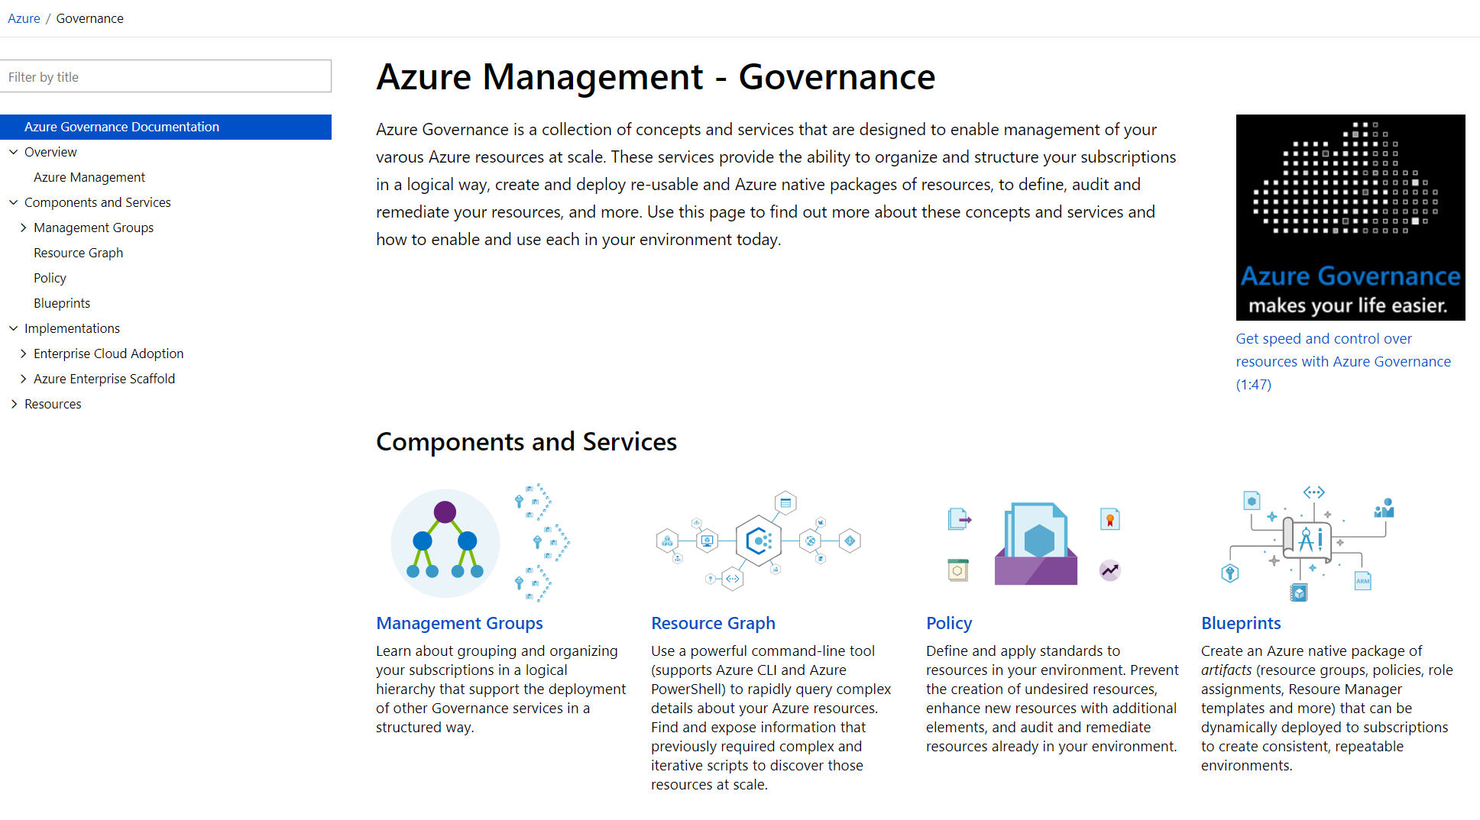
aka.ms/GovernanceDocs -or- docs.microsoft.com/azure/governance
Notes:
Case study for MS: https://www.microsoft.com/en-us/itshowcase/enabling-enterprise-governance-in-azure

Slide 25
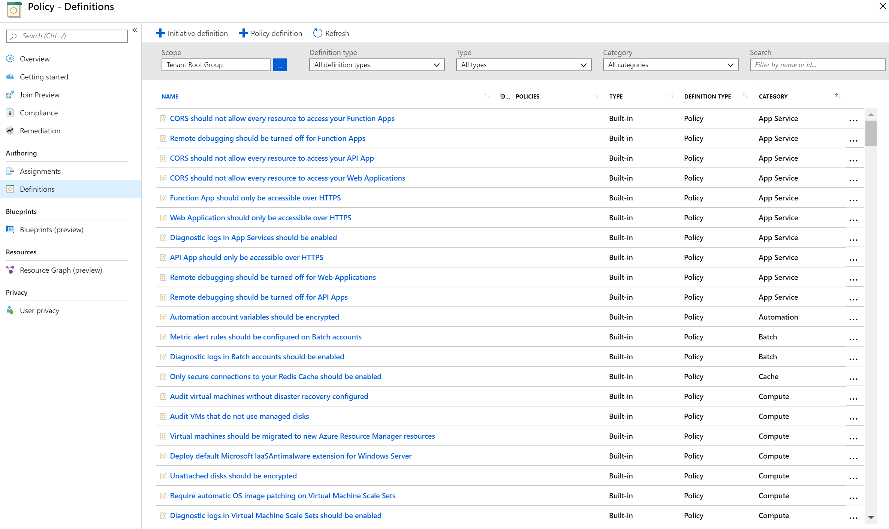

Slide 26
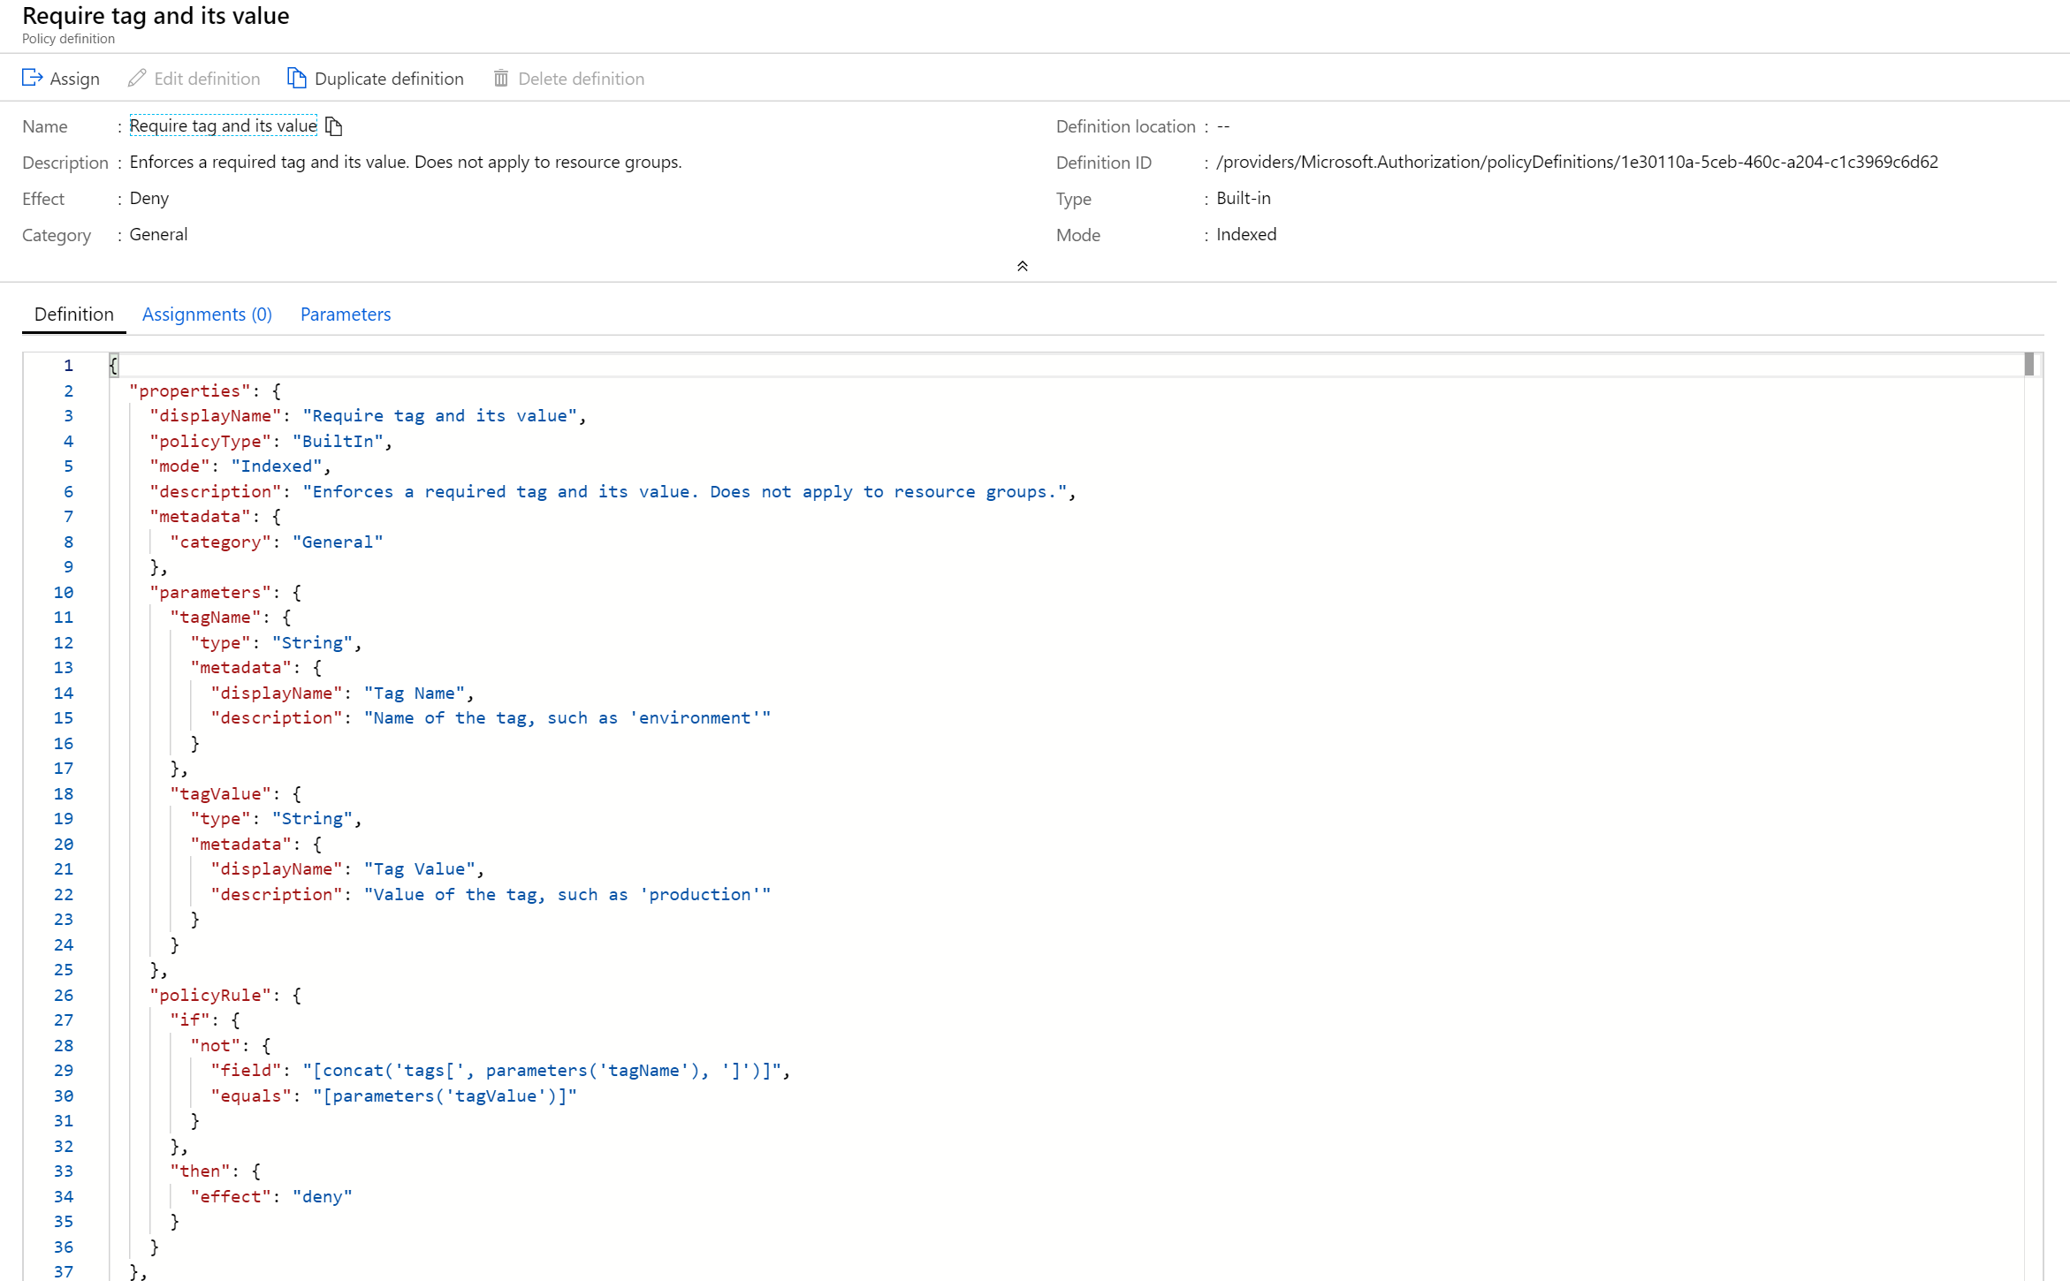

Slide 27
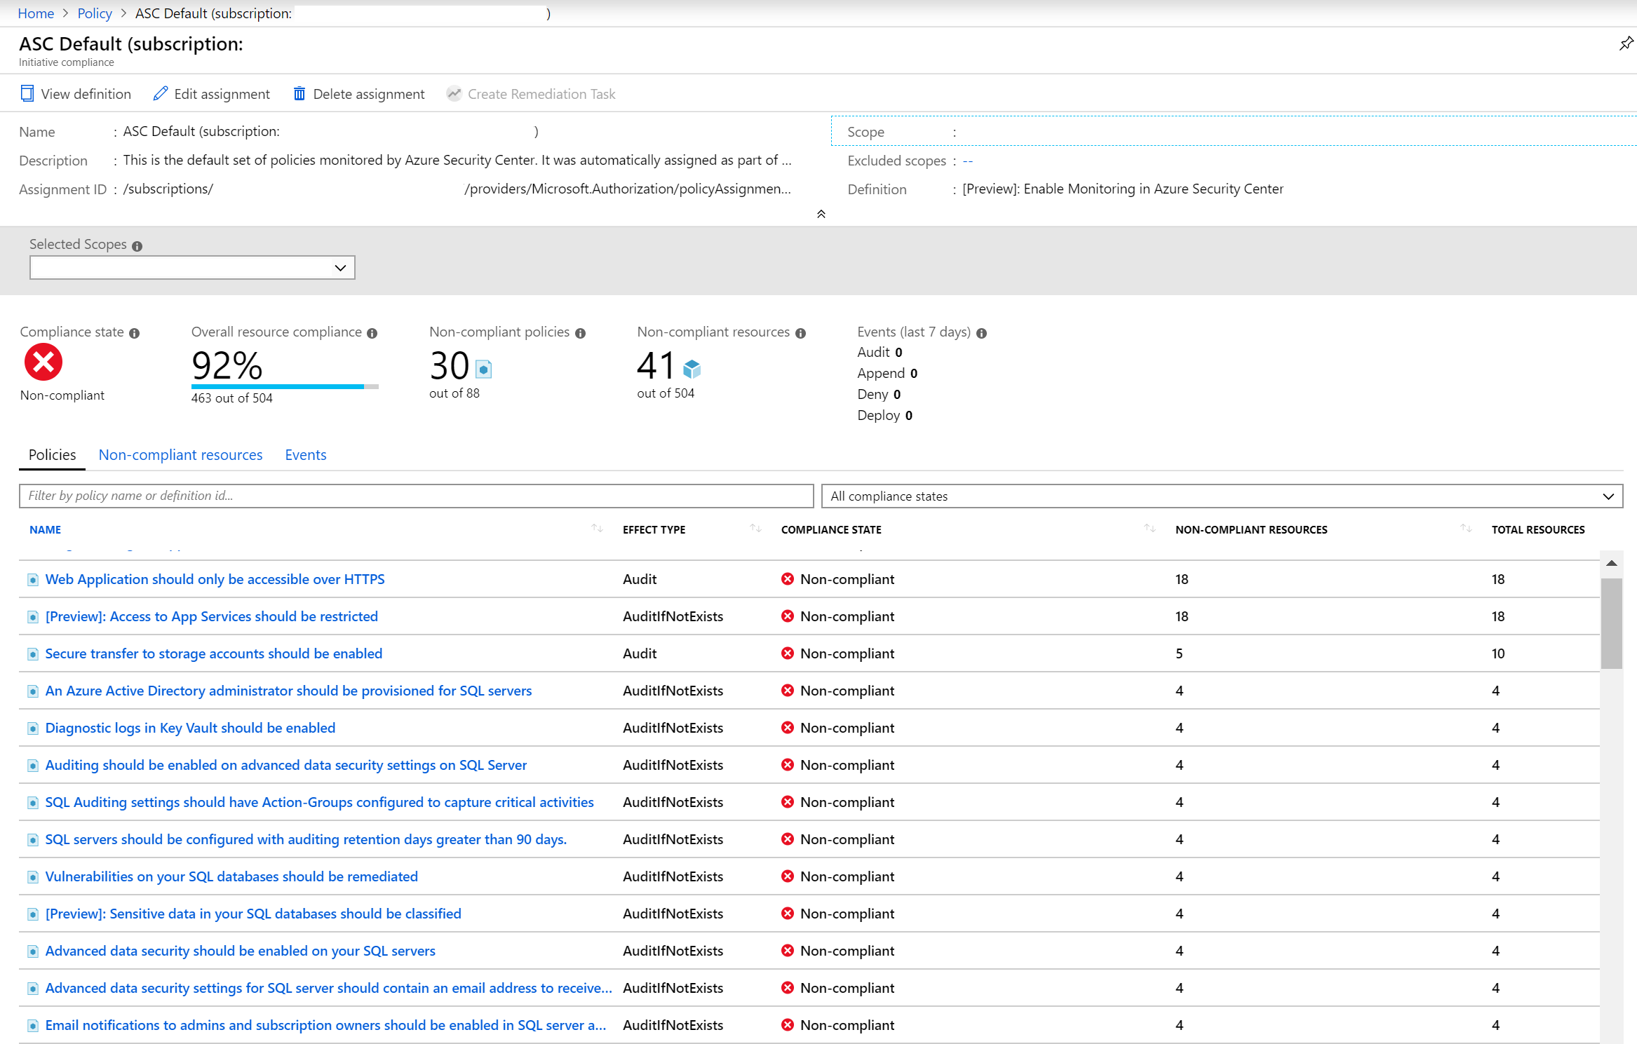

Slide 28
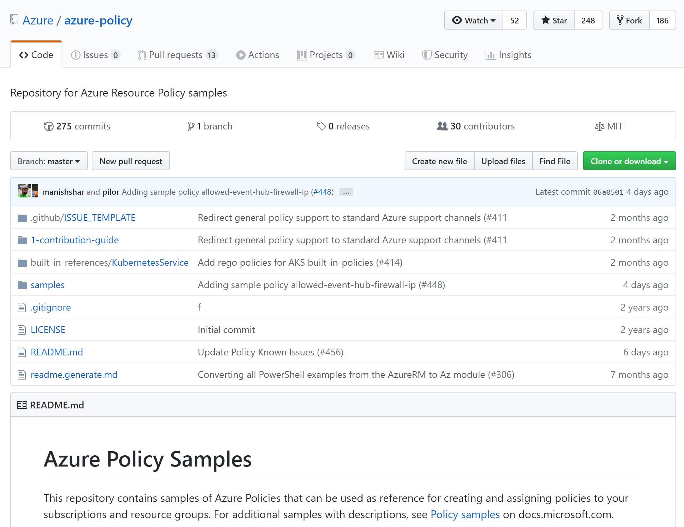
Notes:
https://github.com/Azure/azure-policy

Slide 29
Blueprints
‘Governance as code’
Single artefact collecting:
Policies
RBAC assignments
ARM artefacts
Resource Groups
Versioned
Applied to subscriptions – assignments

Slide 30
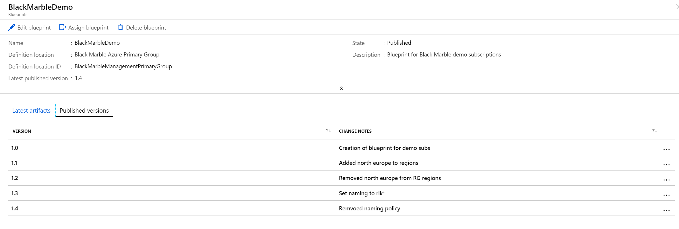

Slide 31
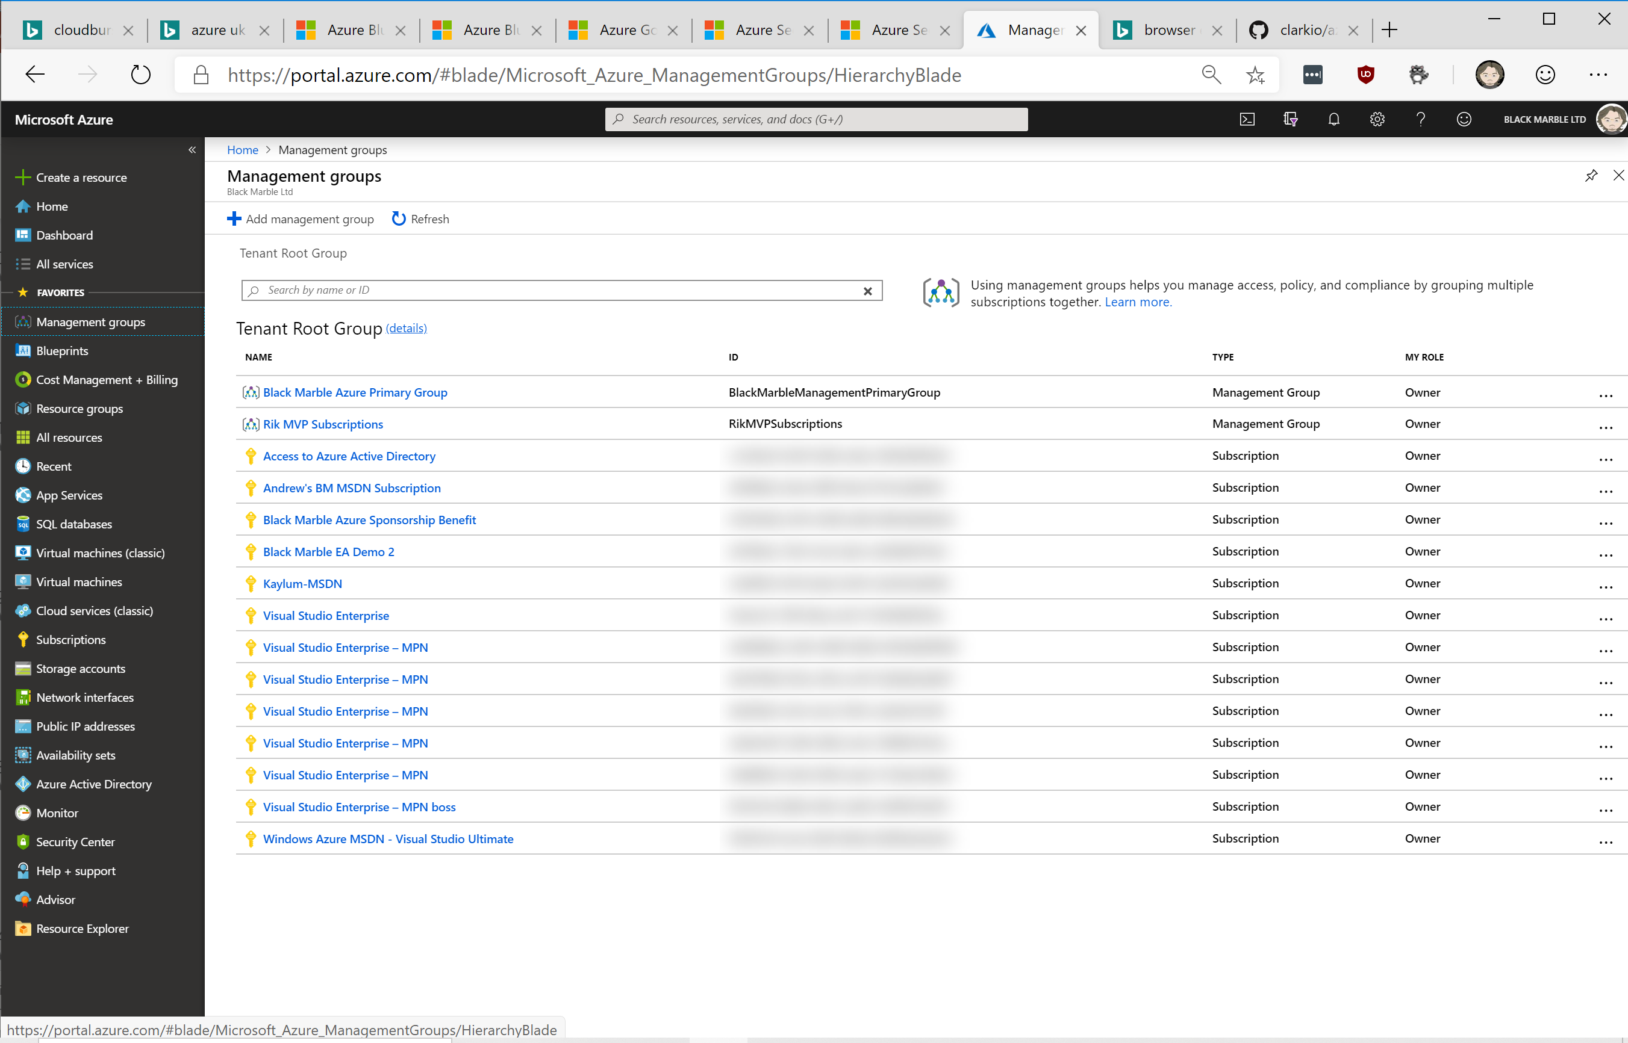
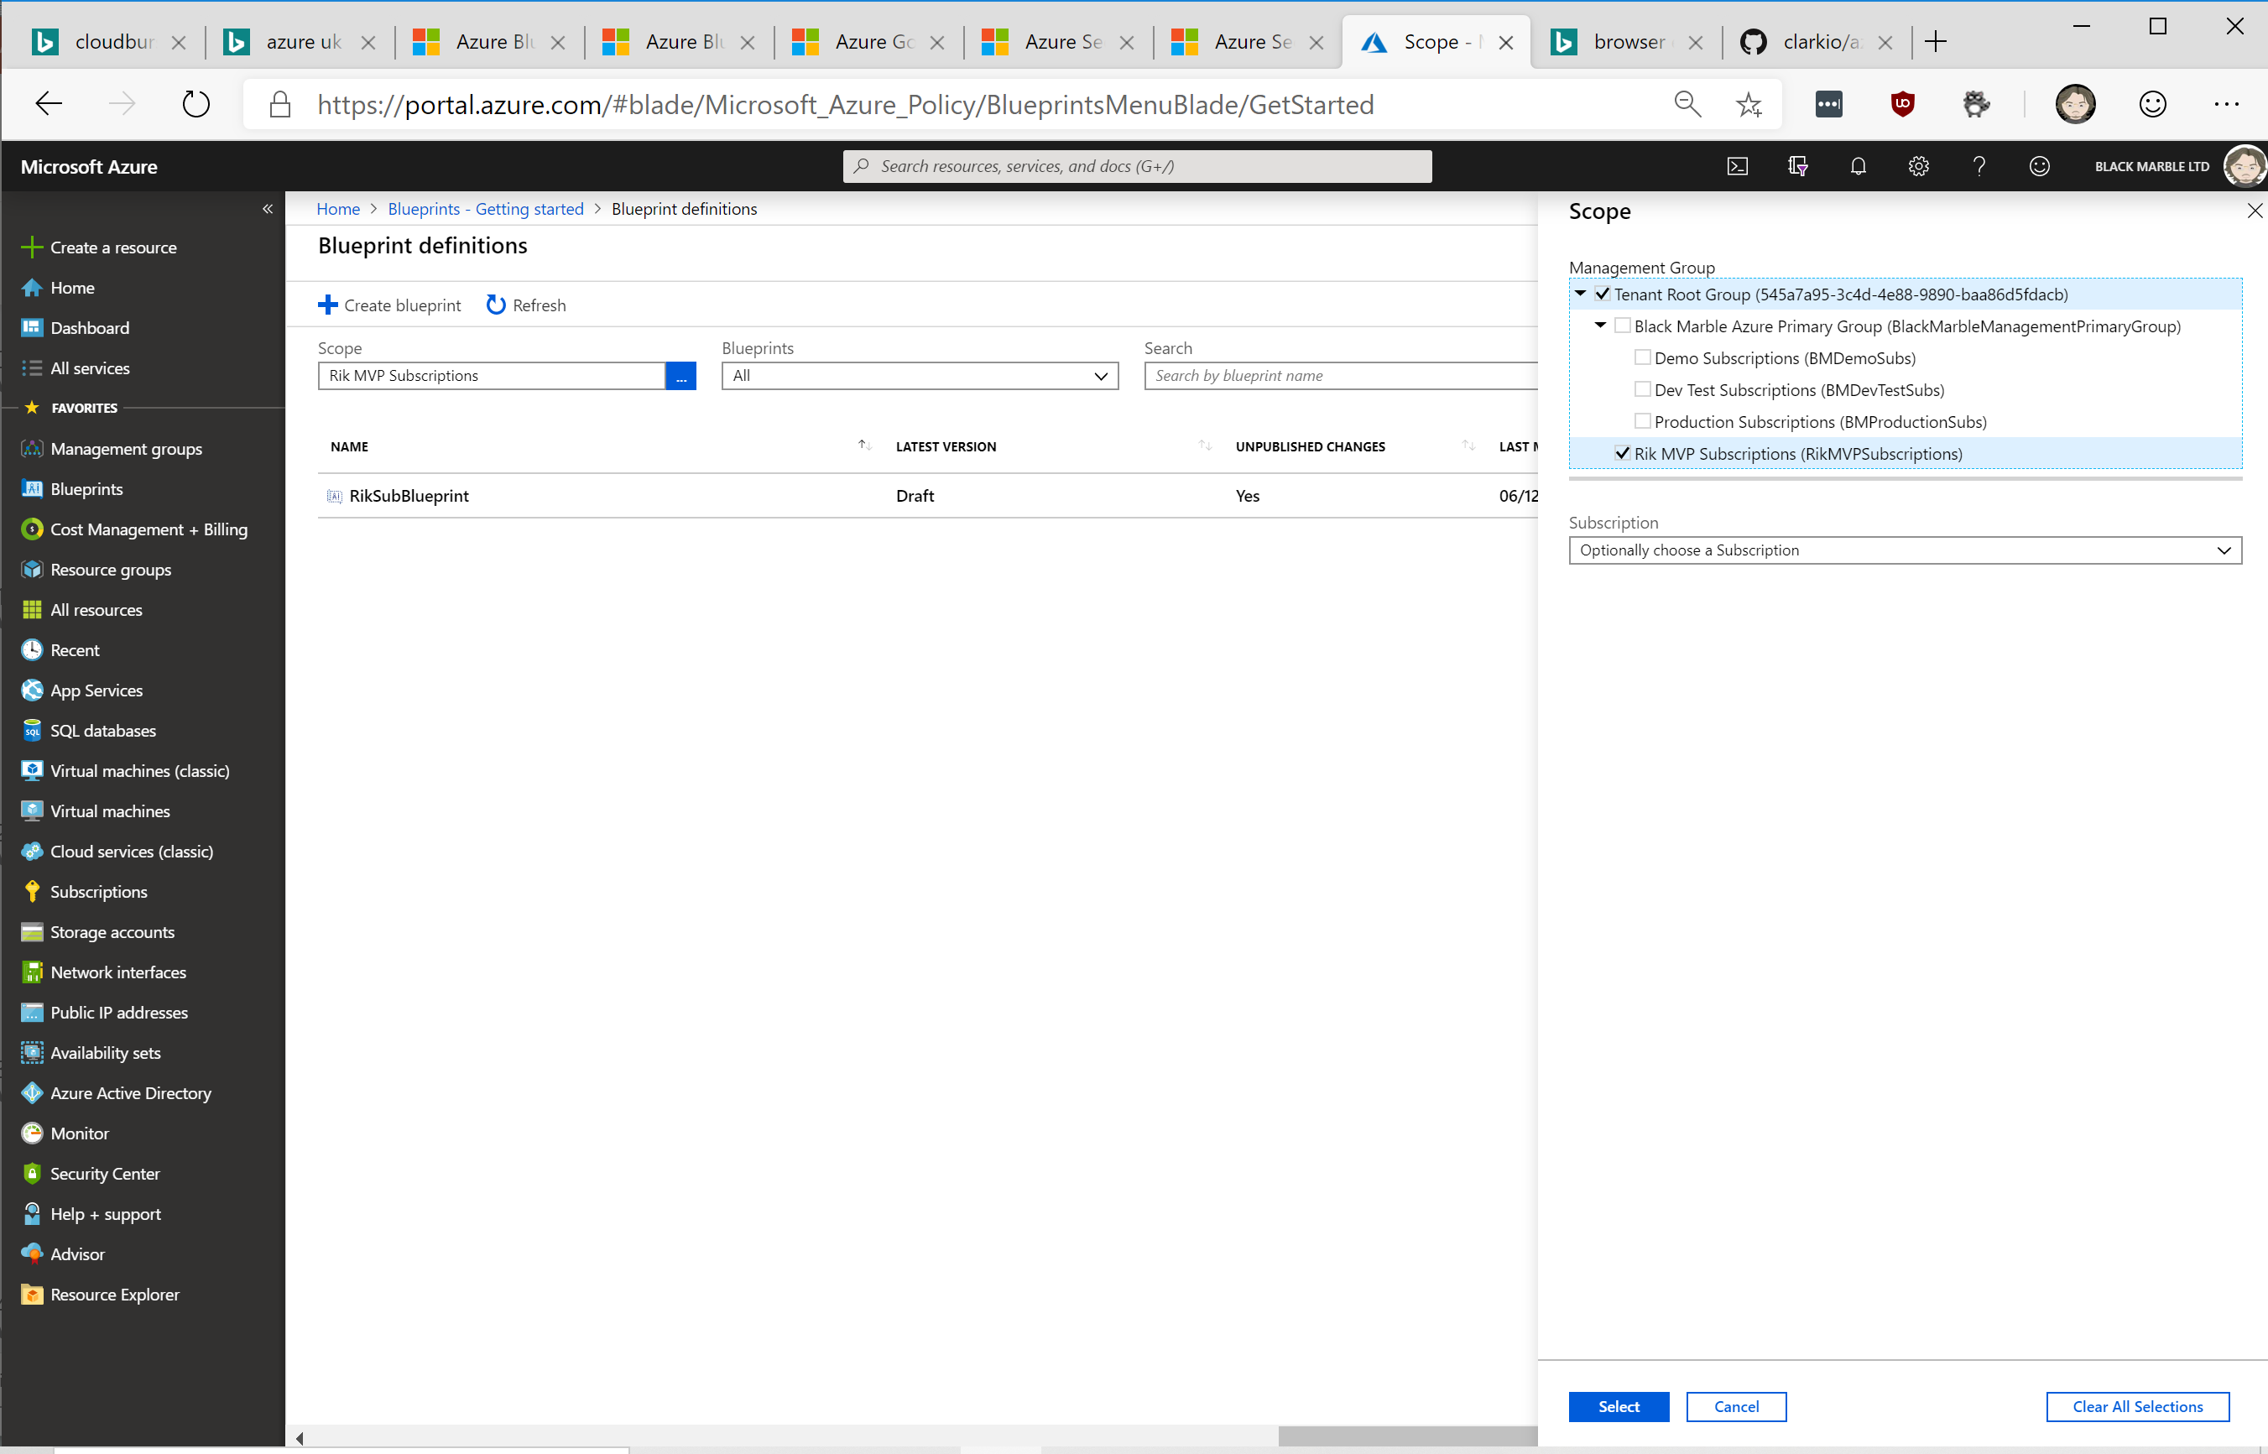
Combine Management Groups and Blueprints

Slide 32
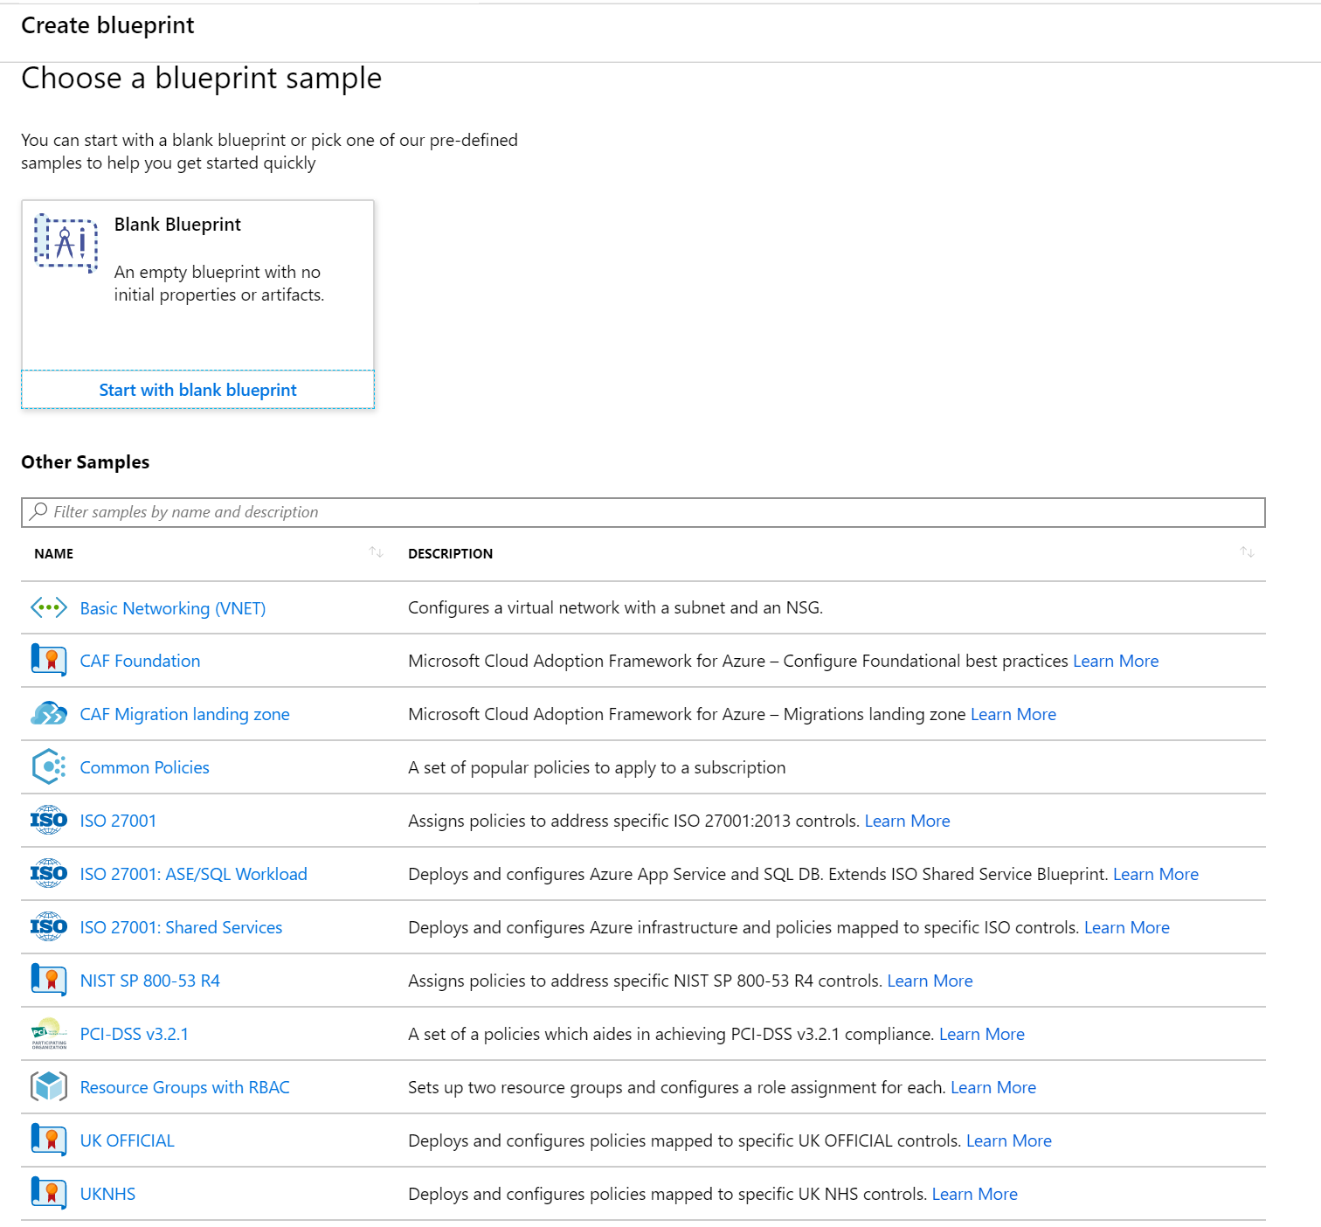
Samples
Available when creating
Include some of those ‘other’ Azure Blueprints

Slide 33
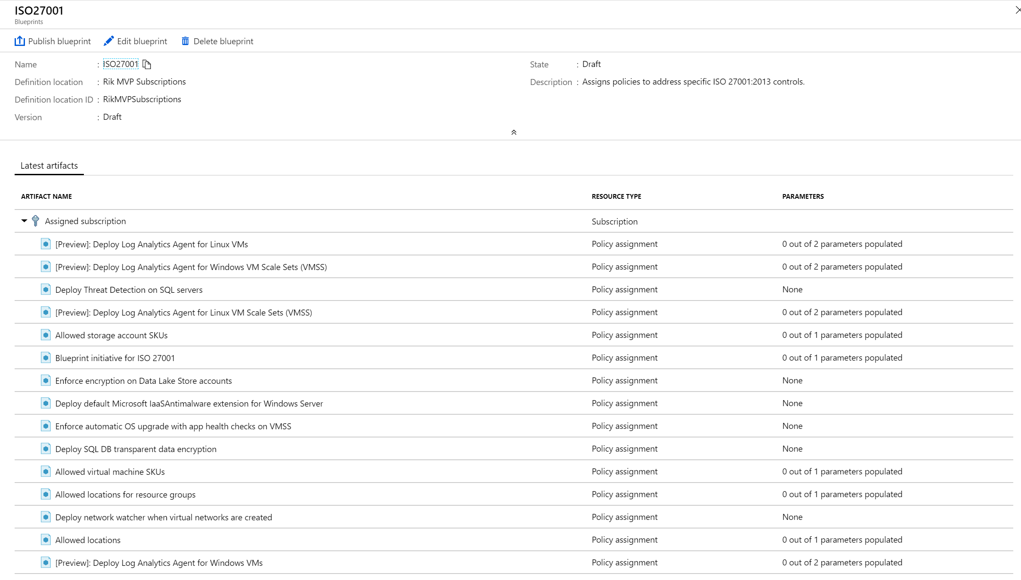

Slide 34
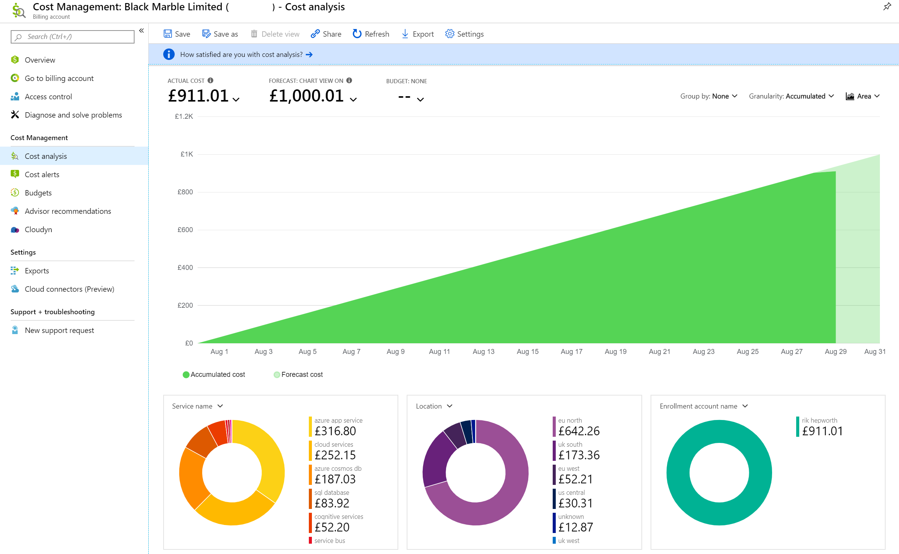

Slide 35
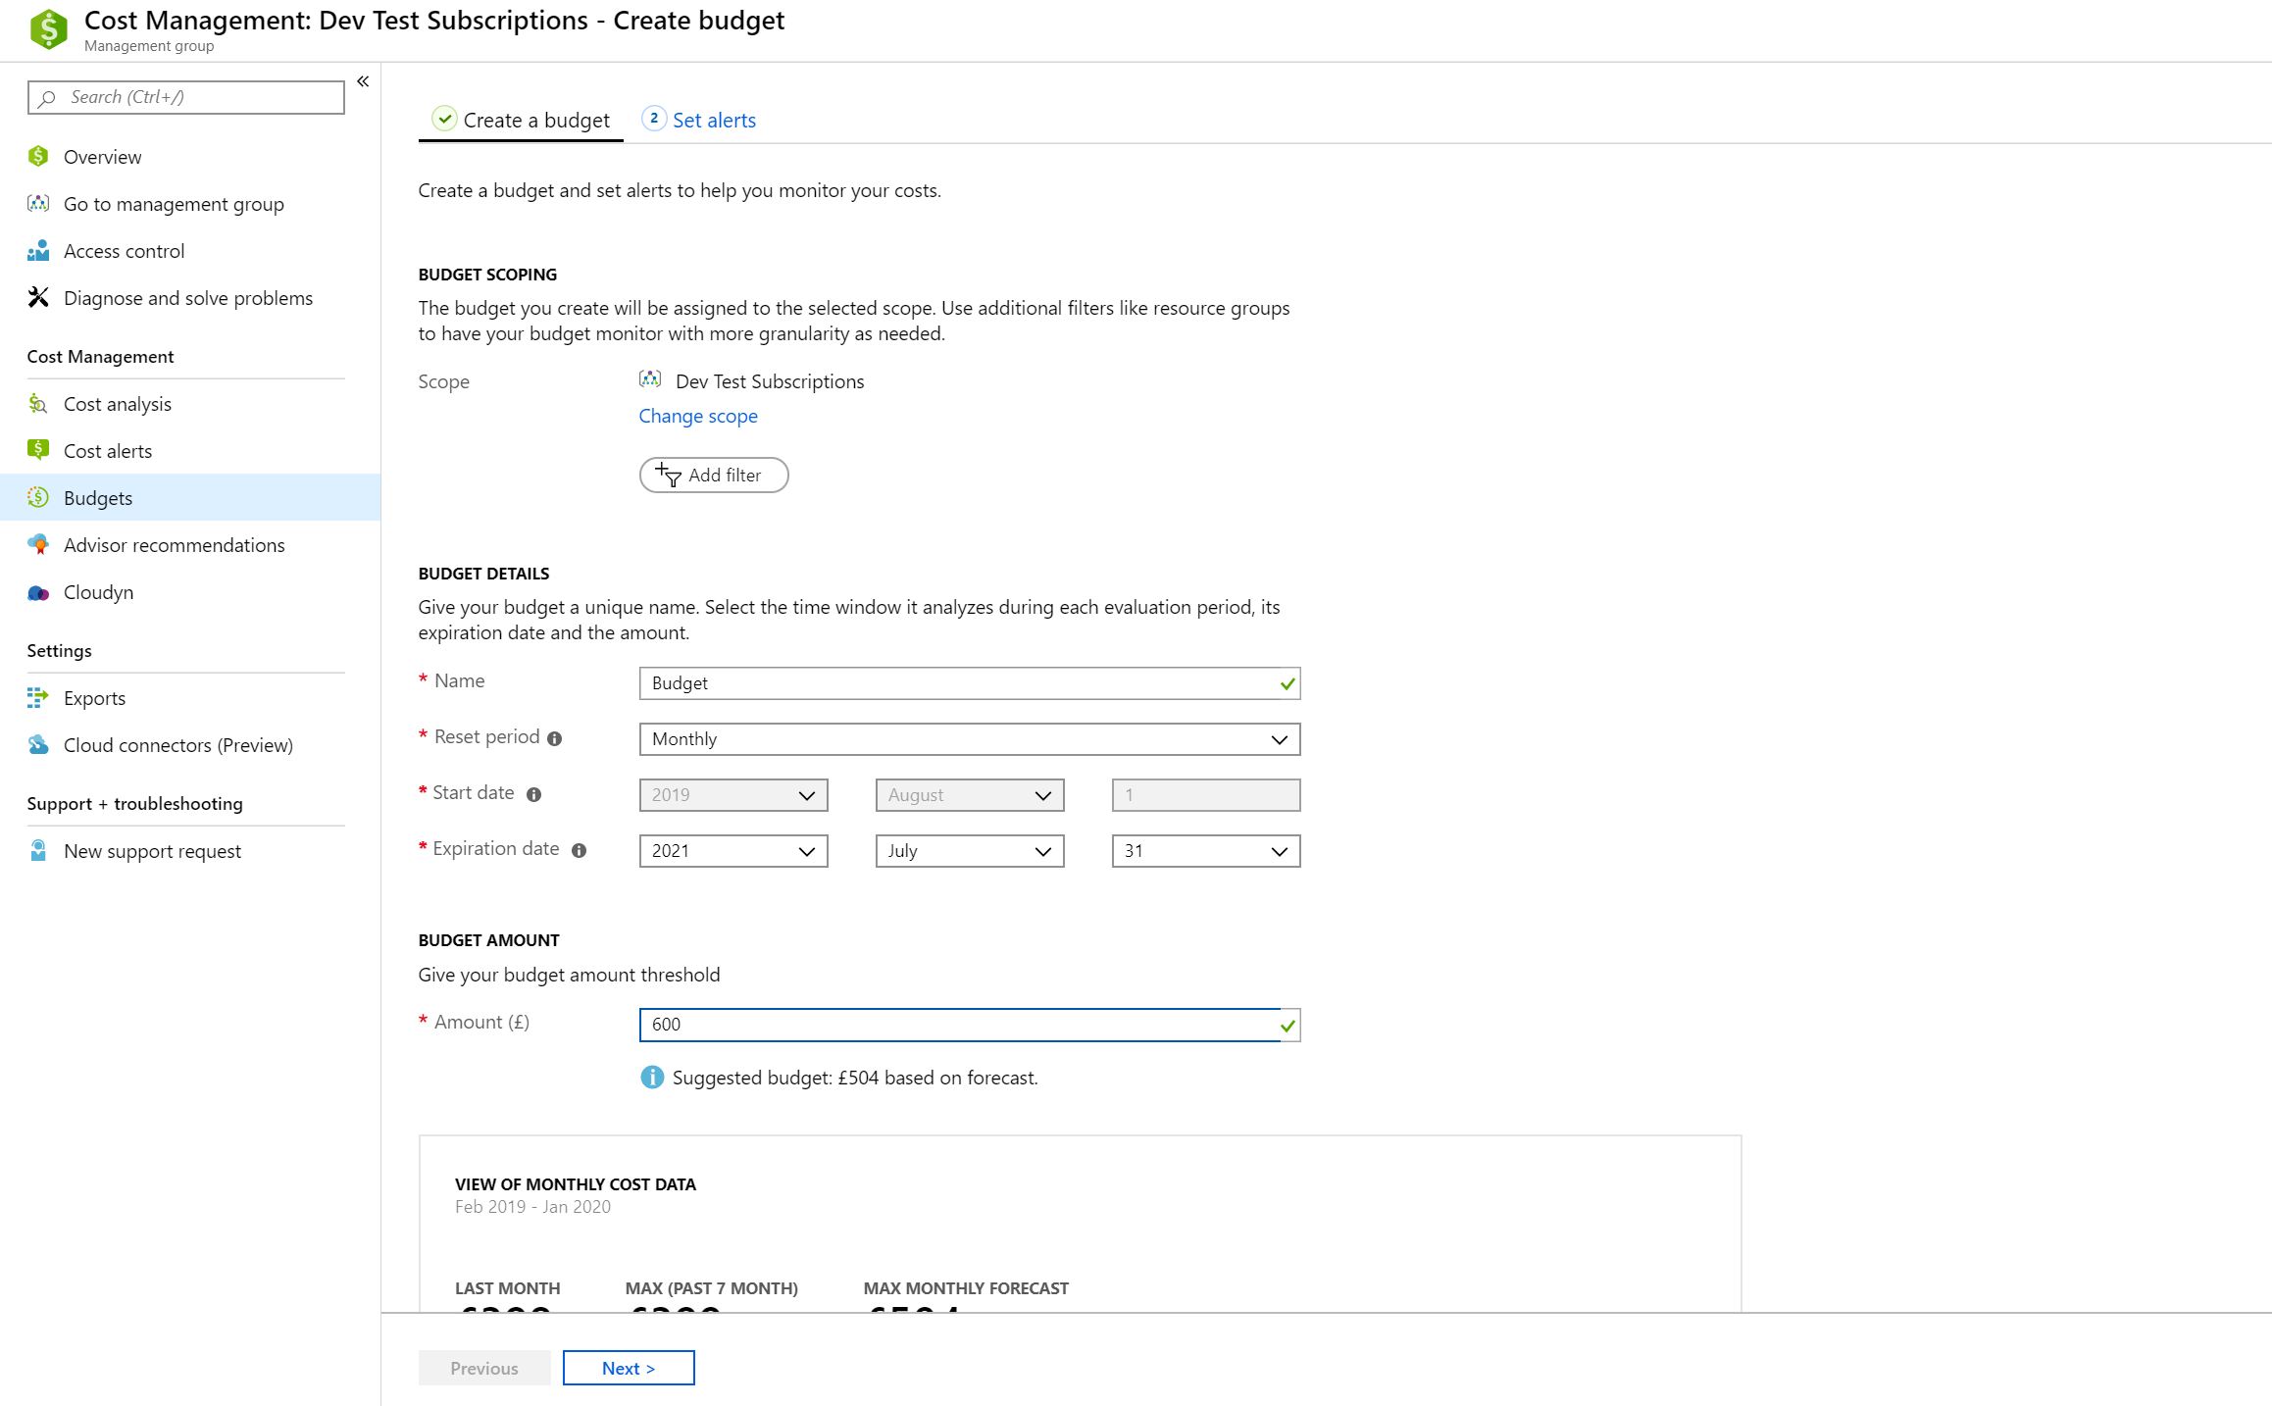

Slide 36
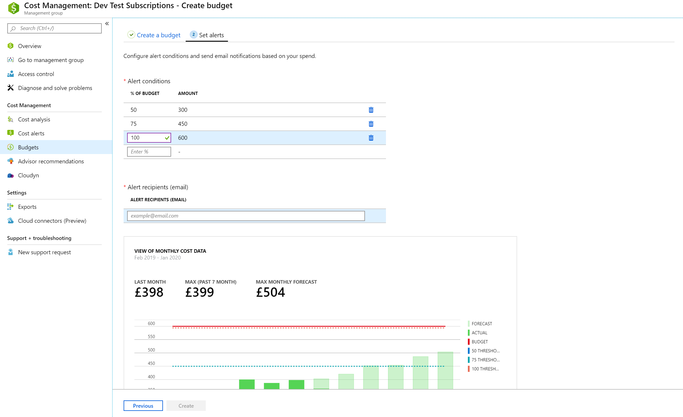

Slide 37
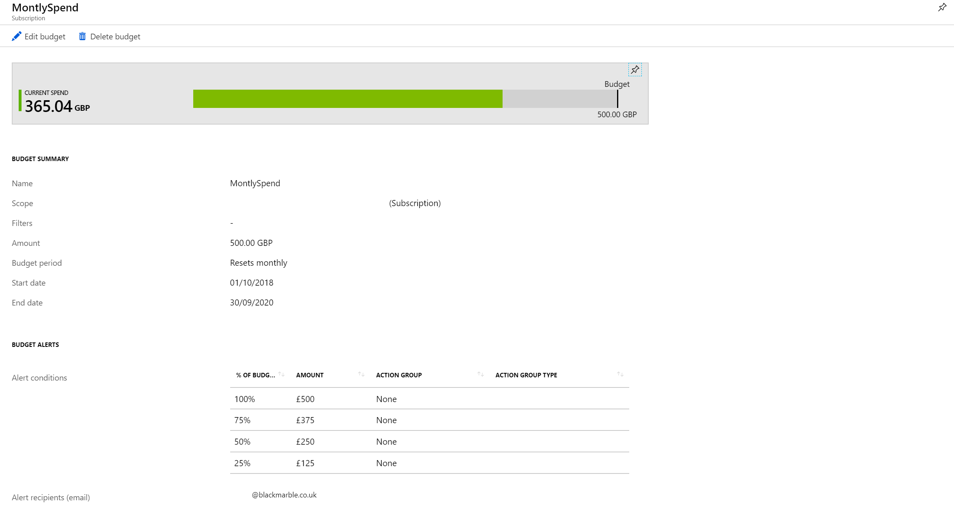

Slide 38
